Slide 1
Module 1: Lesson 1 – Conventional Tillage

Slide 2
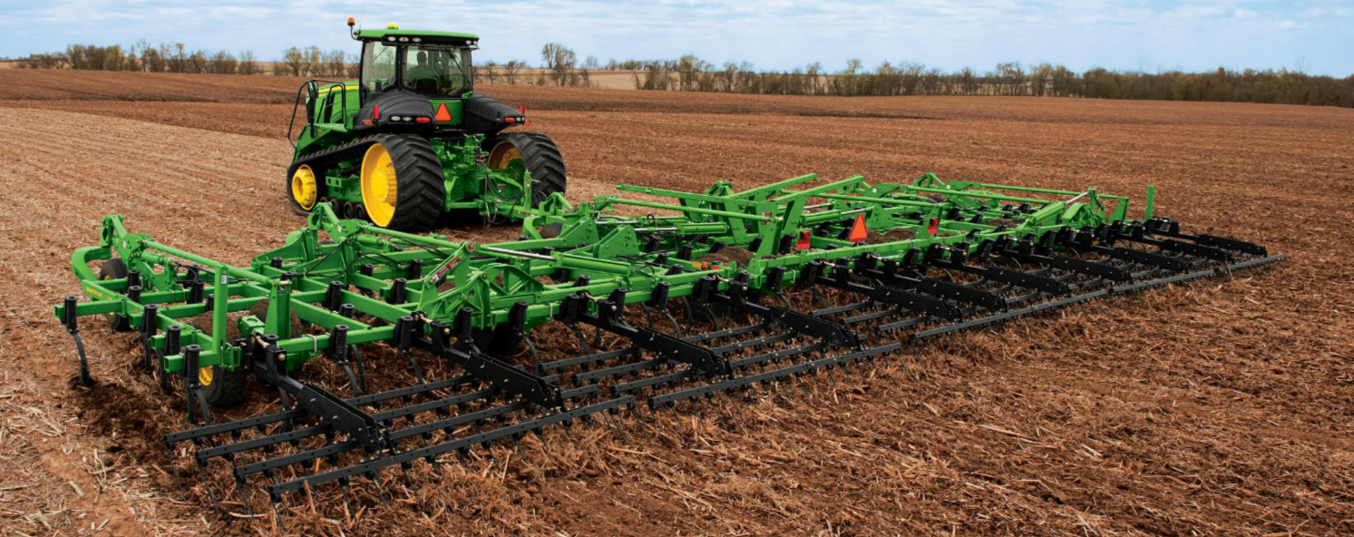
Introduction: What is Tillage?
Tillage is the mechanical disturbance of the soil in preparation for planting
Purpose
Seedbed Preparation
Weed Control
Residue Management
Soil Aeration

Slide 3
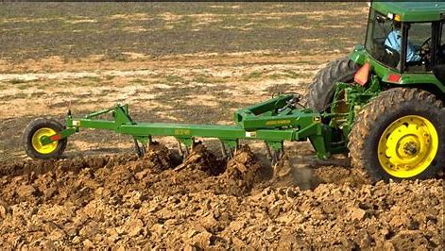
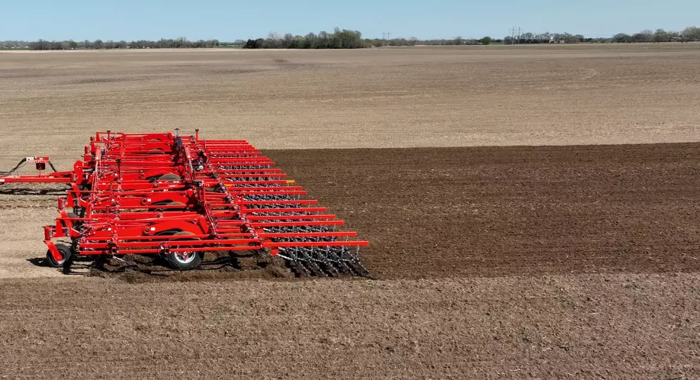
Types of Tillage
Primary Tillage - Deep and Heavy Soil Disturbance
Secondary Tillage - Shallow and Fine Soil Preparation
Notes:
Ask Students:
Q: What differences do you notice between these two fields?
A: The left field has large clumps of dirt and looks very rough. The right field looks smoother, and the dirt clumps are finer
Q: Which field looks better to plant in?
A: The right field.

Slide 4
What is Primary Tillage?
Primary tillage is the first soil tillage operation after the last harvest.
Effects of primary tillage
Breaks up compacted soil layers
Buries weeds and crop residue
Enhances water infiltration
May cause soil erosion if done excessively
Depth: Typically 6-24 inches deep
Common primary tillage implements include
Moldboard Plow
Chisel Plow
Ripper/Subsoil Plow

Slide 5
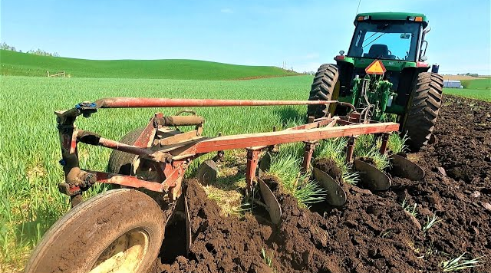
Moldboard Plow
Turns over the entire top layer of soil
Best used in heavy residue fields and for breaking new ground or sod
Advantages: Excellent weed control, completely buries residue
Disadvantages: High fuel use, soil erosion risk, reduces organic matter.
Kibble Equipment - The Last Plow Sold by John Deere
Notes:
Disadvantages: Reduces organic material

Slide 6
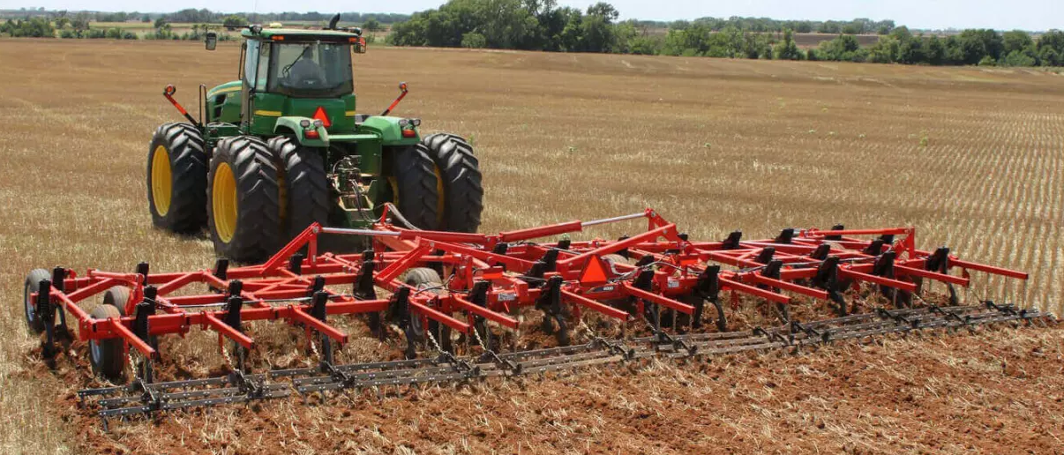
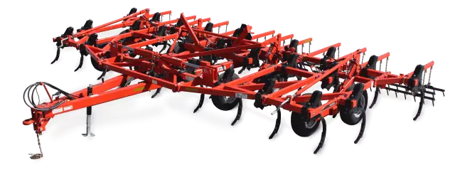
Chisel Plow
Loosens soil but leaves residue on the surface
Best used for breaking up compacted soil without excessive soil disturbance
Advantages: Reduced soil erosion (compared to moldboard plow).
Disadvantages: Doesn’t fully bury weeds or residue
2021 Wil-Rich Chisel Plow Video

Slide 7
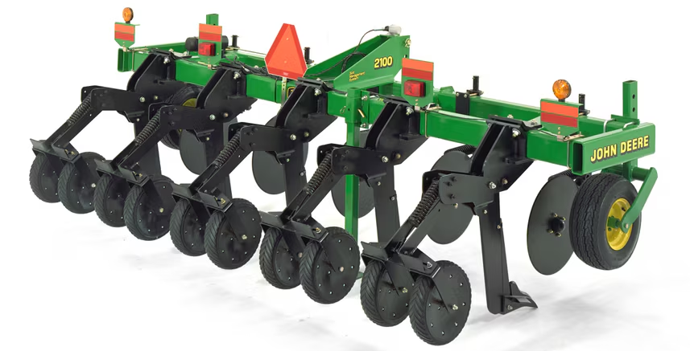
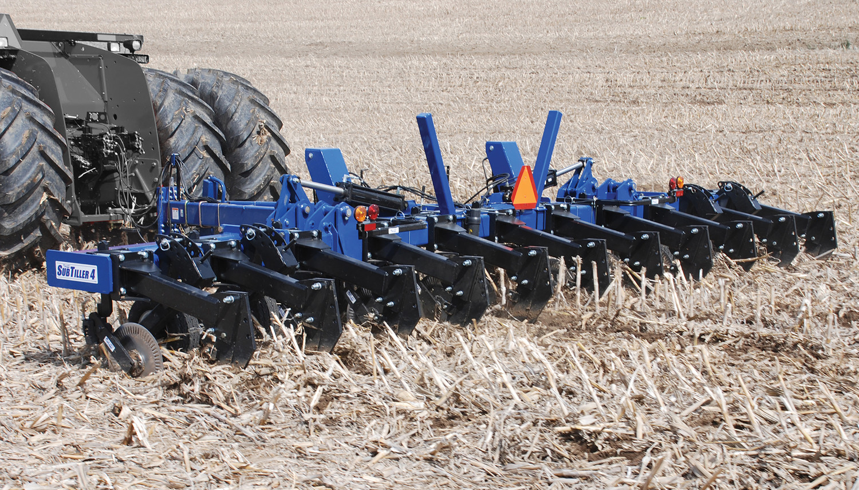
Ripper/Subsoil plow
Uses deep shanks to break up soil deep below the surface without turning the soil over
Best used for breaking up compacted soil layers
Advantages: relieves soil compaction, improves drainage, preserves soil structure
Disadvantages: High Horsepower requirements, does not mix residue.
How to Use a Ripper / Field Cultivator - Gardening Series

Slide 8
What is Secondary Tillage?
Secondary tillage is the process of preparing soil for planting after primary tillage.
Effects of secondary tillage
Breaks up large clods from primary tillage
Improves seed-to-soil contact
Reduces weed competition
Helps with moisture conservation
Depth: Shallower - 2-6 inches
Common primary tillage implements include
Field Cultivator
Disk Harrow
Rolling Baskets/Soil Conditioner

Slide 9
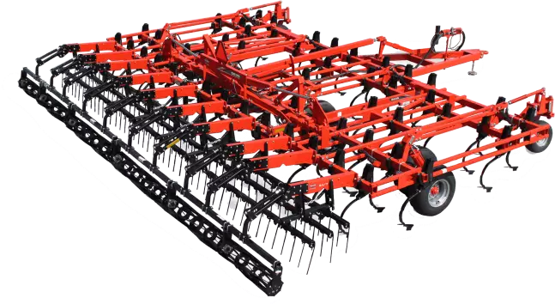
Field Cultivator
Uses rows of shanks to aerate the soil while breaking up large clods
Best used for preparing a smooth and even seedbed and for light weed control
Advantages: helps incorporate herbicides and fertilizers, low fuel and horsepower requirements
Disadvantages: Less effective in high-residue fields and has a limited penetration depth

Slide 10
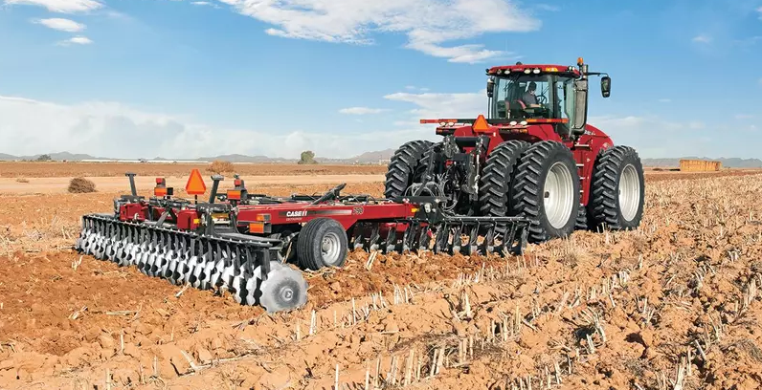
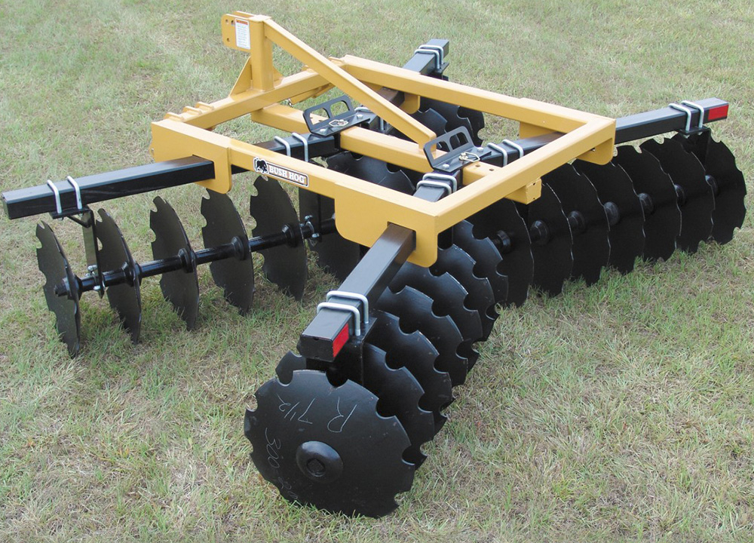
Disk Harrow
Uses rows of concave disks to slice through the soil and mix residue
Best used for breaking clods of dirt and smoothing soil after primary tillage
Advantages: Good for incorporating residue and herbicides. Can be adjusted for different soil conditions
Disadvantages: Multiple passes may be needed, high risk of compaction
How to Use a Disc Harrow - The Gardening Series

Slide 11
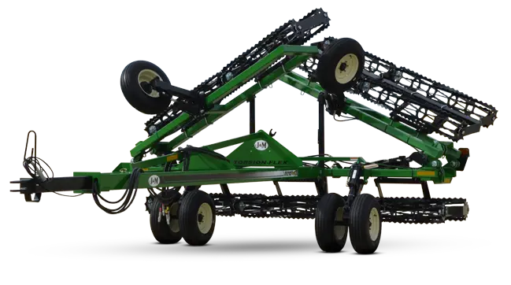
Rolling Basket/Soil Conditioners
Rollers with metal bars break up small clods and firm the soil surface
Best used for final soil preparation before planting
Advantages: Prevents soil crusting, enhances seed-to-soil contact
Disadvantages: Very limited affect on soil compaction, requires secondary tillage for best results
K-AG Basket Rollers | Farming - YouTube

Slide 12
Summary
 | Primary Tillage | Secondary Tillage
Depth | Deep (6-24 inches) | Shallow (2-6 inches)
Purpose | Initial soil preparation | Seedbed refinement
Tools Used | Plows, Subsoiler | Harrows, Cultivator
Timing | First operation | After primary tillage

